Slide 2
objectives
Render image color given spectral information
Find hyperspectral image databases
Demonstrate how color changes under varying illumination
Color information is affected by light source, object spectral property, and sensor sensitivity.
Spectral information is a more stable descriptor of an object.
There is a variety of hyperspectral databases available.
Converting spectral information into color is necessary for many reasons.
Physics-301/Activity 2 - Spectral Imaging.ipynb at main · reneprincipejr/Physics-301 (github.com)
https://drive.google.com/file/d/11CcCc9426zSVE6Q-W3ltP06D5uXa8Y3v/view?usp=sharing

Slide 3
Background
Color is trinity which implies that what we see is a product of three things:
the power distribution of the source,
reflectance of the object, and
the sensor sensitivity.
Among the three, reflectance is the object’s only property hence, changing the source and the sensor can totally change how the object looks. This makes the color a subjective property of the object [1].
In this activity, I demonstrate how color is rendered and how it changes perceptually under different illuminations.

Slide 4













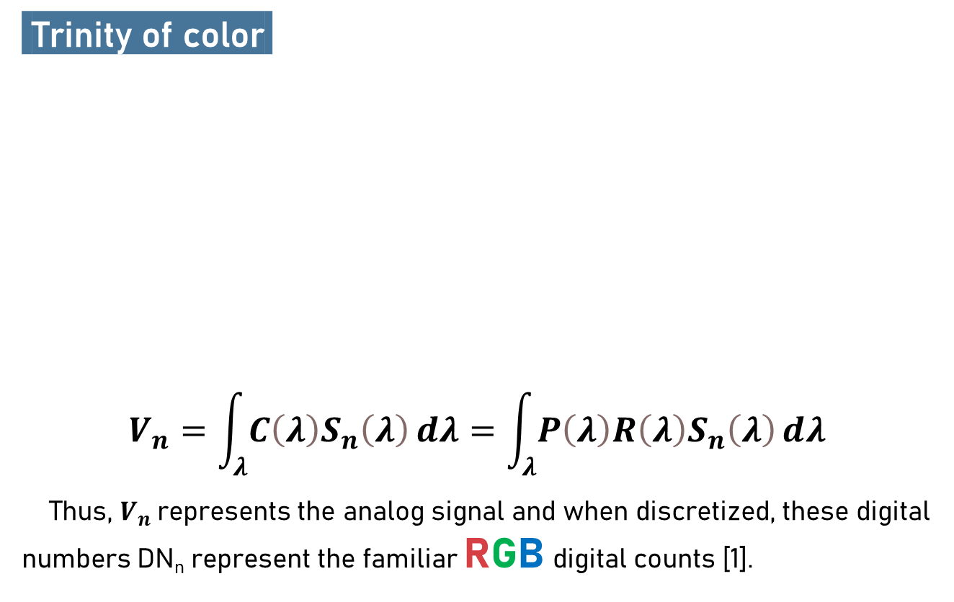
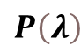

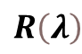
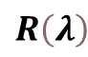
Methodology
Trinity of color.
$$V_{n}=\int_{λ}{C\left(λ\right)S_{n}\left(λ\right)ⅆλ}=\int_{λ}{P\left(λ\right)R\left(λ\right)S_{n}\left(λ\right)ⅆλ}$$
Thus, $V_{n}$represents the analog signal and when discretized, these digital numbers DN_{n} represent the familiar RGB digital counts [1].
$$P\left(λ\right)$$
Spectral Power
$$S_{R}\left(λ\right) S_{G}\left(λ\right) S_{B}\left(λ\right)$$
Camera Spectral Sensitivity
$$R\left(λ\right)$$
$$R\left(λ\right)$$
Object Spectral Reflectance

Slide 5
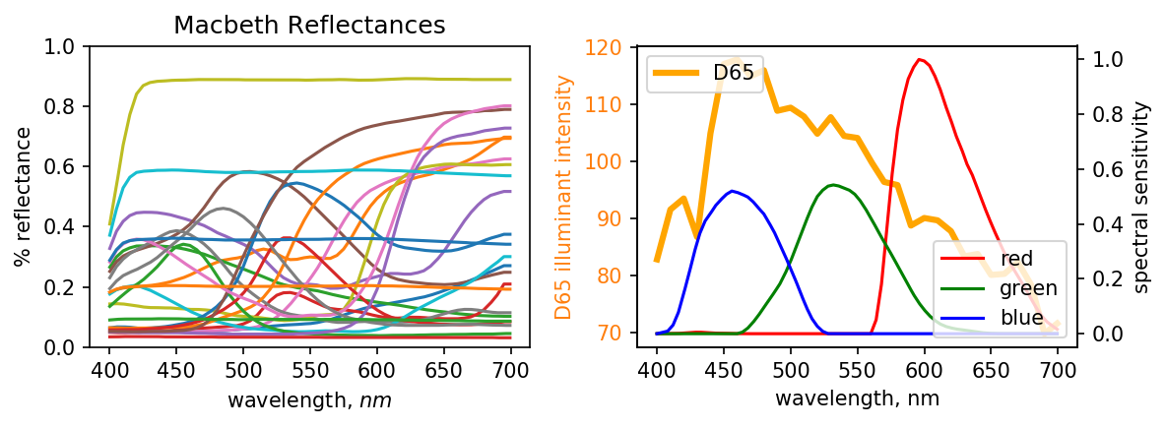
Procedure
In this activity, we use the Macbeth color chart as our reflectance set, D65 as our power source, and Canon 400D’s sensitivity to simulate colors. Note that data interpolation was imposed such that the element-to-element matrix multiplication can be carried out easily. Overall, we render the spectral values from 400 nm to 700 nm, with wavelength interval of 1 nm. After multiplying the spectral trinity, the area under the curve are the designated the RGB values.

Slide 6
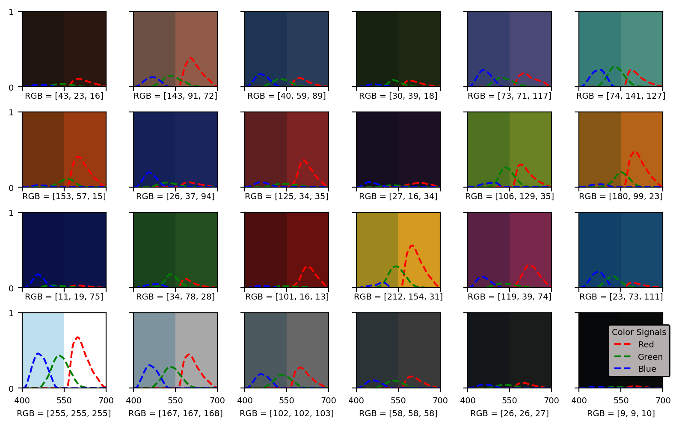
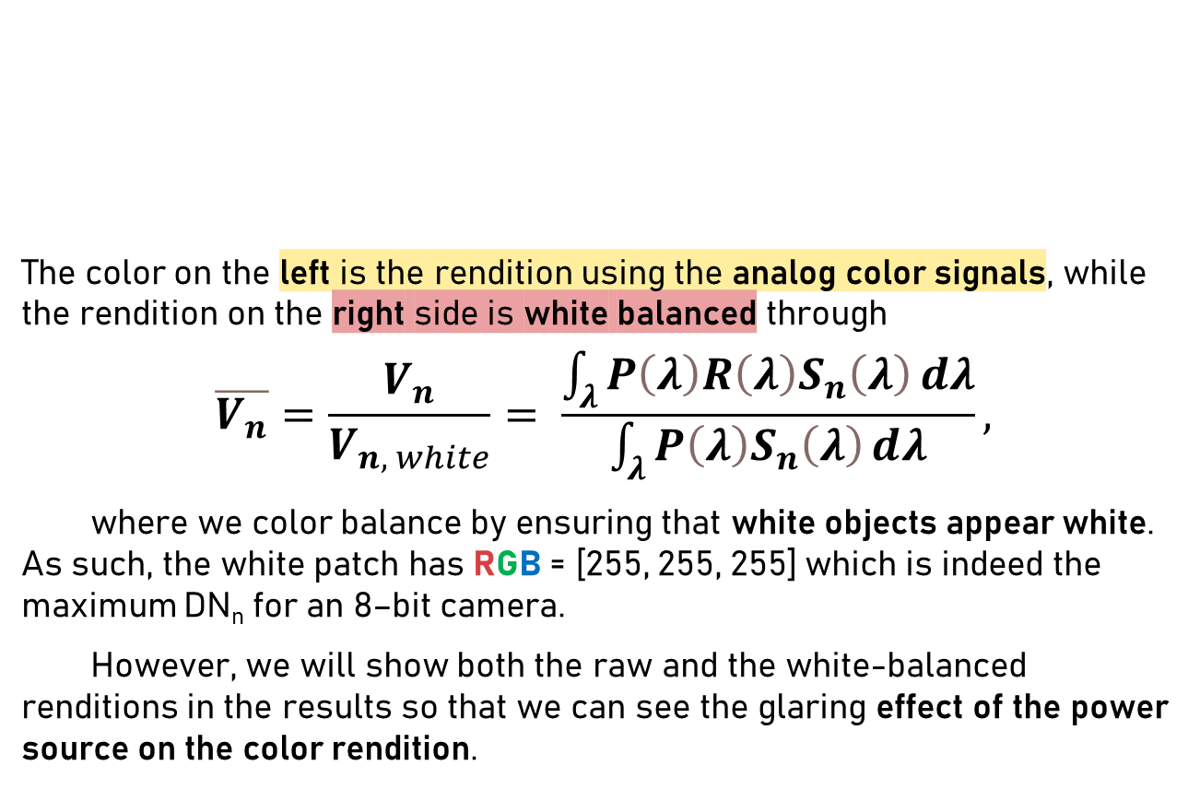
White Balancing
The color on the left is the rendition using the analog color signals, while the rendition on the right side is white balanced through
$$\overline{V_{n}}=\frac{V_{n}}{V_{n, white}}= \frac{\int_{λ}{P\left(λ\right)R\left(λ\right)S_{n}\left(λ\right)ⅆλ}}{\int_{λ}{P\left(λ\right)S_{n}\left(λ\right)ⅆλ}},$$
where we color balance by ensuring that white objects appear white. As such, the white patch has RGB = [255, 255, 255] which is indeed the maximum DN_{n} for an 8–bit camera.
However, we will show both the raw and the white-balanced renditions in the results so that we can see the glaring effect of the power source on the color rendition.

Slide 7
Results: Color Simulation

Slide 8
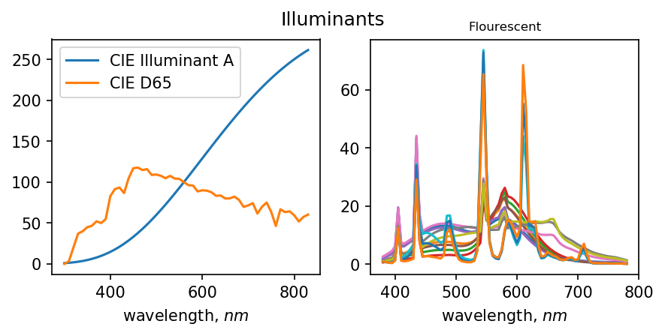
Discussion
From the renditions carried out, we can see how white balancing allows us to see the true colors of the Macbeth color chart. However, it’s important to note that the bluish initial renditions are due to the fact the D65 illuminant has a stronger signal on the shorter wavelengths, which is intuitively a blue-dominant region.
In the next part, we also simulate colors using Illuminant A and Fluorescent as sources to see how color changes under varying illumination. From the power distribution alone, a red-orange tint on the colors should be visible under Illuminant A.

Slide 9
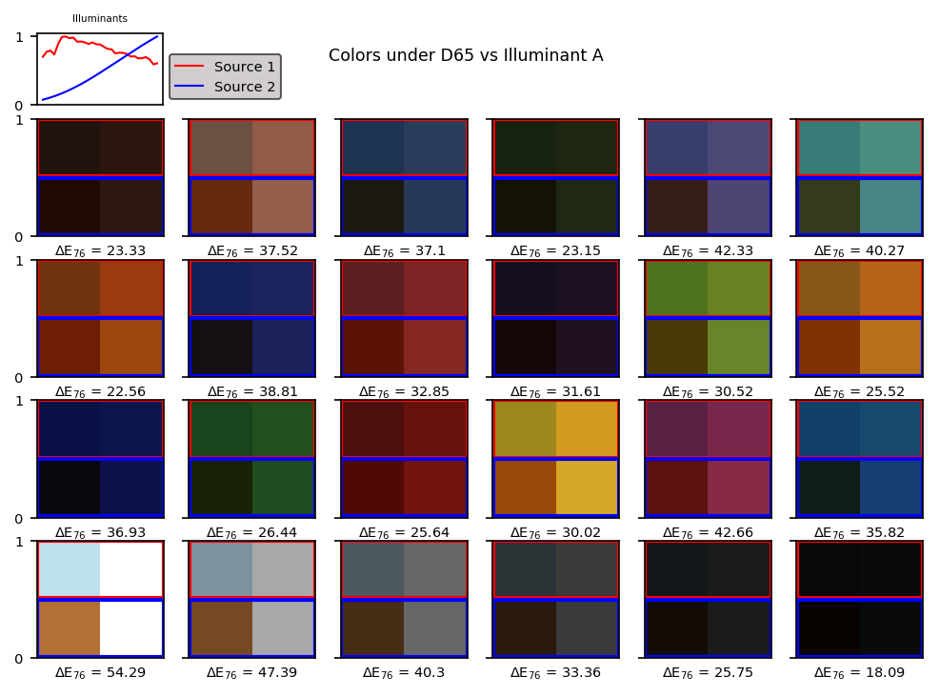
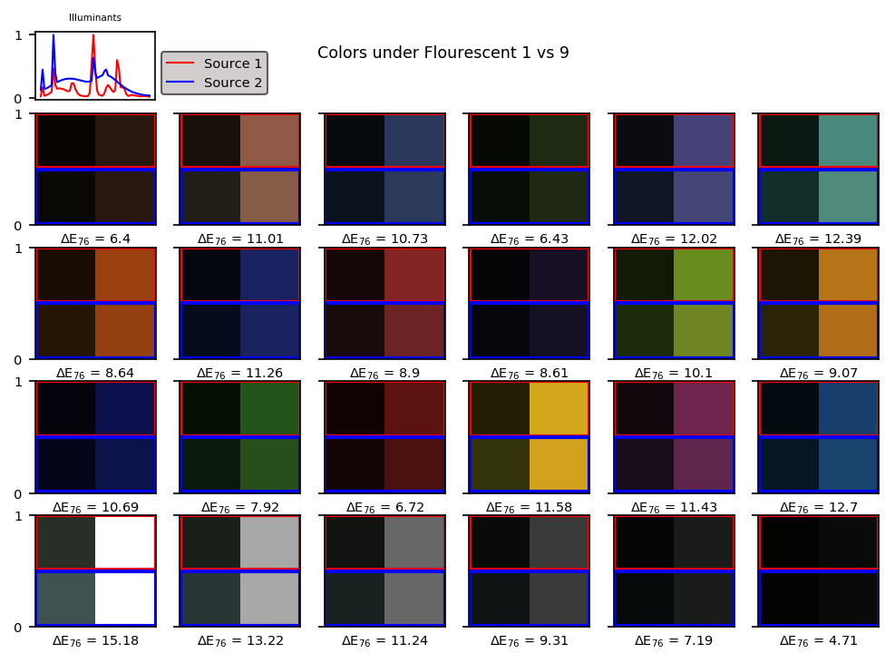
Color Difference
Color difference ΔE₇₆ is a measure of the Euclidean distance between the two spectra transformed in the CIELAB uniform color space. Here, we compare the source modulated spectra [2]. The ΔE₇₆ measures how different the colors are before they are white balanced, where larger ΔE₇₆ implies greater perceptual difference. For example, under two very different sources (D65 vs Illuminant A), large ΔE₇₆. is observed and the colors rendered appear very different as well.
Meanwhile, under two similar fluorescent sources, renditions show difference in brightness but is consistent in color as shown by low ΔE₇₆.

Slide 11
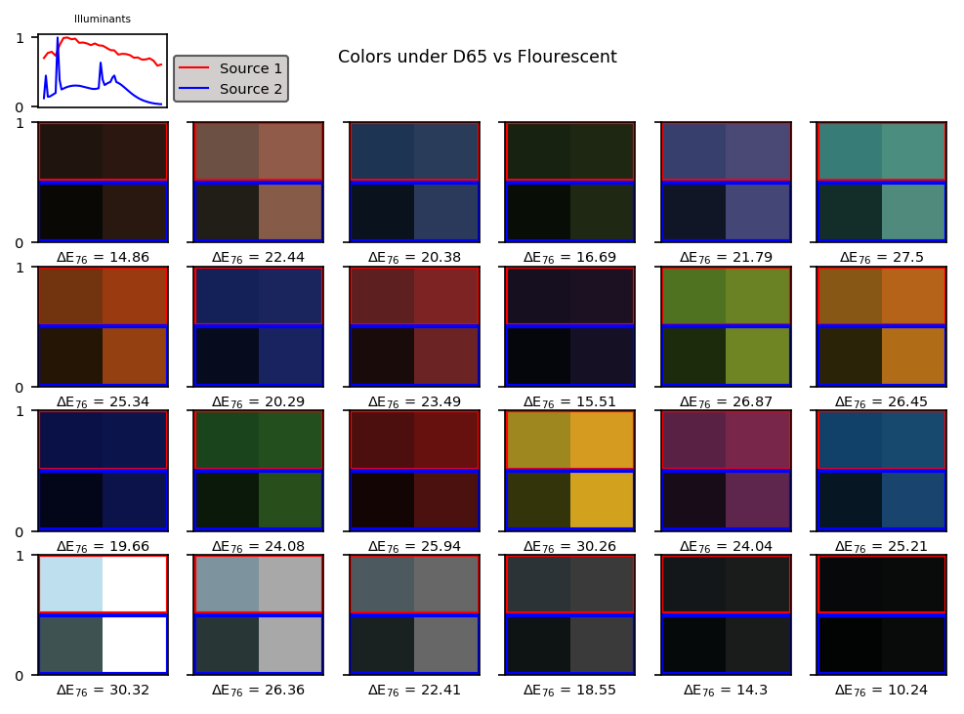

Slide 13
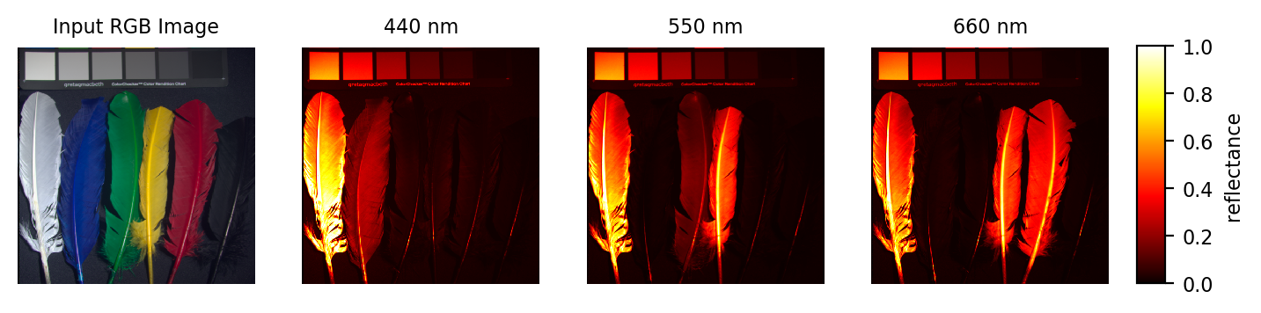
Hyperspectral imaging
Now, we extend the rendition into the domain of hyperspectral image cube which contains two spatial and one spectral dimension. Essentially, think of each single pixel in the image as an object which has its own reflectance information. Employing the same spectral imaging technique, we can render an entire RGB image instead of a single patch.
Here we use the CAVE hyperspectral dataset [3]. The spectral images shown below are snapshots at a given wavelength. As expected, the blue feathers had high reflectance on the bluish wavelengths (near 400 nm). The yellow-green and the red-yellow feathers show high reflectance on 550 nm and 660 nm, respectively. The white feather is highly reflective across all wavelength; very opposite to how the black feather reflects light.

Slide 14
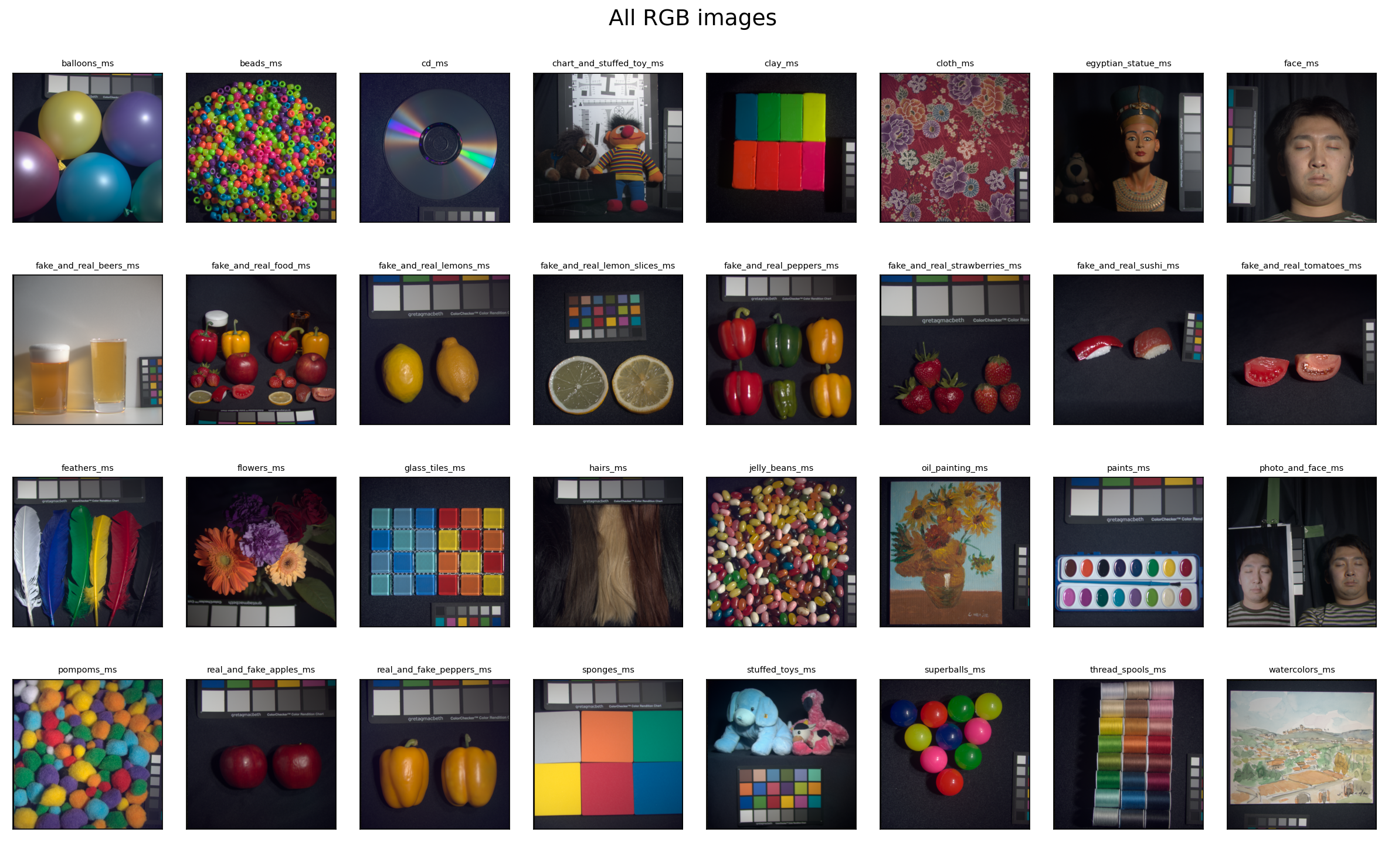
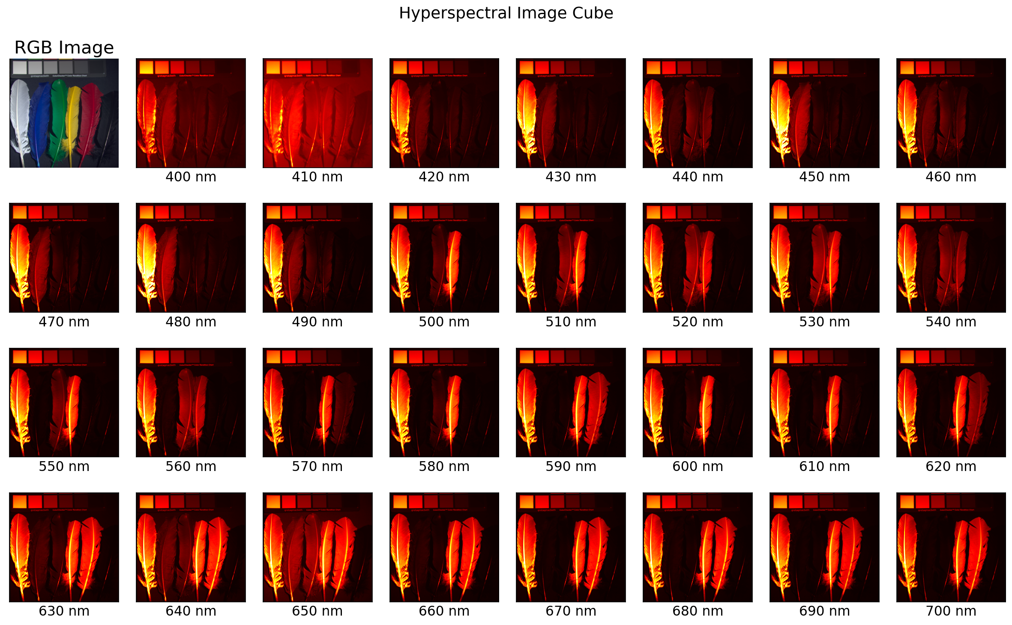
CAVE Hyperspectral Dataset
32 hyperspectral images of challenging objects
31 spectral channels from 400-700 nm (dλ = 10 nm)

Slide 15
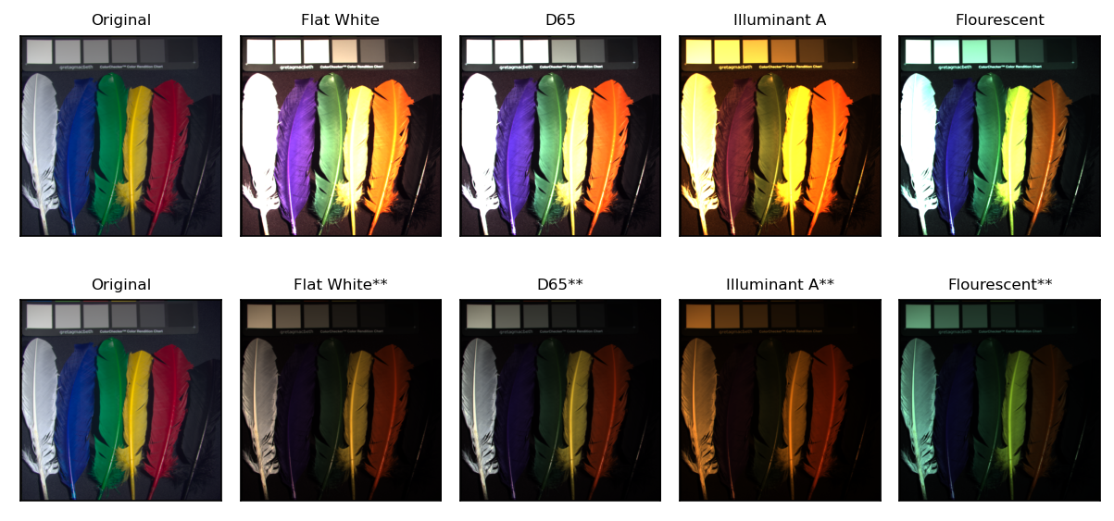
Simulations
Raw RGB renditions under various illuminants
White-balanced about the absolute maximum value

Slide 16
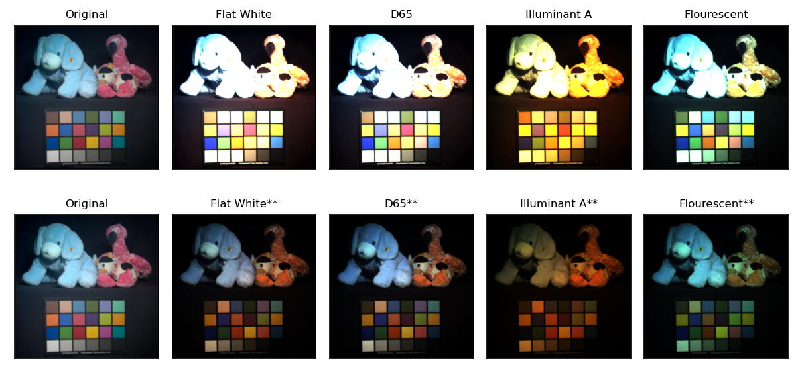
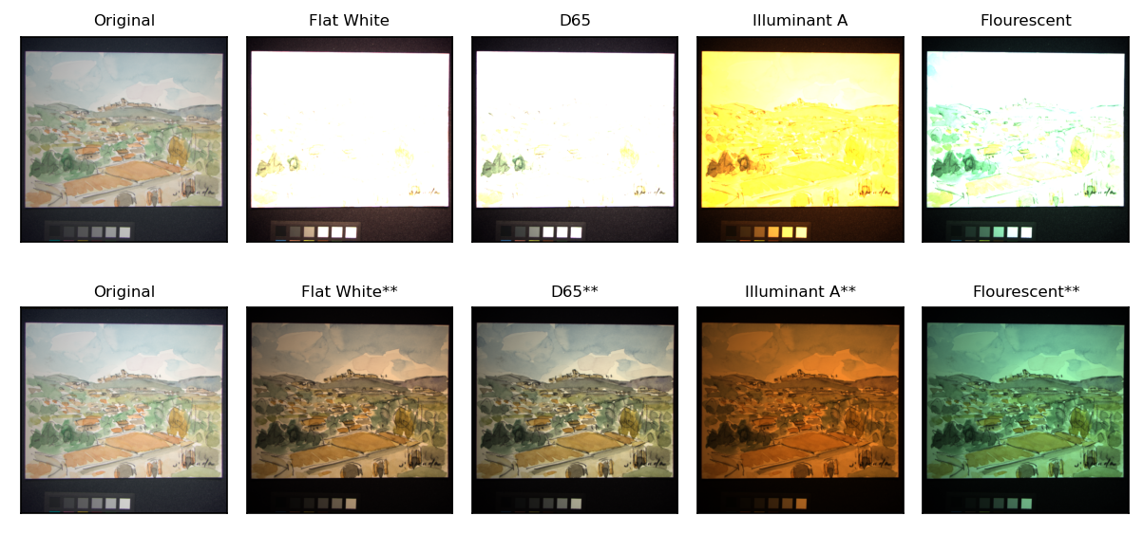
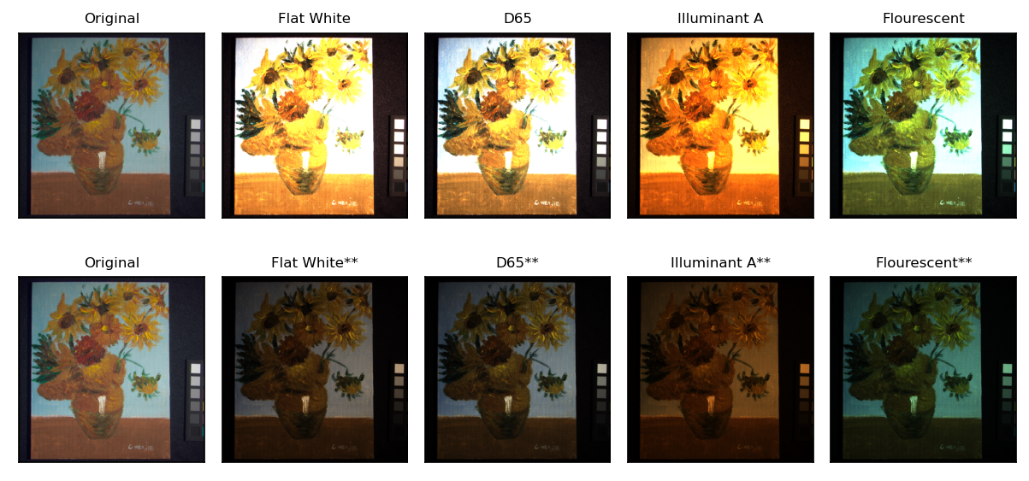
More Renditions

Slide 17
reflection
I’m very much in my element in this activity since my undergraduate thesis is about spectral super-resolution via machine learning. I was able to showcase the plot templates that I’ve worked hard on for months. I think my report is very visual and elaborate, practically reinforcing the discussion about color rendition. The objectives were easily met and to scrutinize the technique, I also an added color error metric which supplements what we see visually with actual quantitative measure of color difference. I’m really satisfied with the results that I showed in this report.
For those reasons, I’d give myself a score of 100/100.
[1] M. Soriano, Physics 301 - Spectral Imaging, (2022).
[2] W. Mokrzycki and M. Tatol, Color difference Delta E - A survey, Mach. Graph. Vis. 20, 383 (2011).
[3] F. Yasuma, T. Mitsunaga, D. Iso, and S. K. Nayar, Generalized assorted pixel camera: Postcapture control of resolution, dynamic range, and spectrum, IEEE Trans. Image Process. 19, 2241-2253 (2010).
CIE Illuminants A and D65 : http://www.rit-mcsl.org/UsefulData/D65_and_A.xls
CIE Fluorescent lamps : http://www.rit-mcsl.org/UsefulData/Fluorescents.xls
Macbeth color checker : http://www.rit-mcsl.org/UsefulData/MacbethColorChecker.xls
Canon 400D : https://nae-lab.org/~rei/research/cs/zhao/database.html
THESIS | My Site (rlprincipe.wixsite.com)

